Slide 1



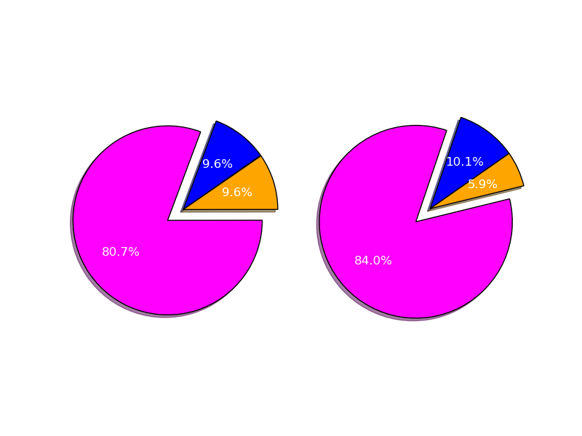
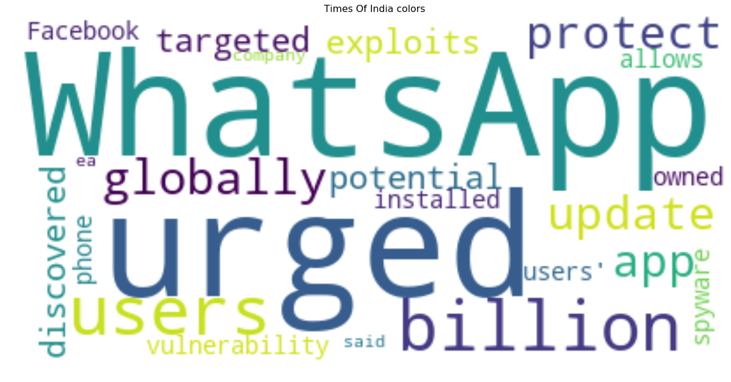
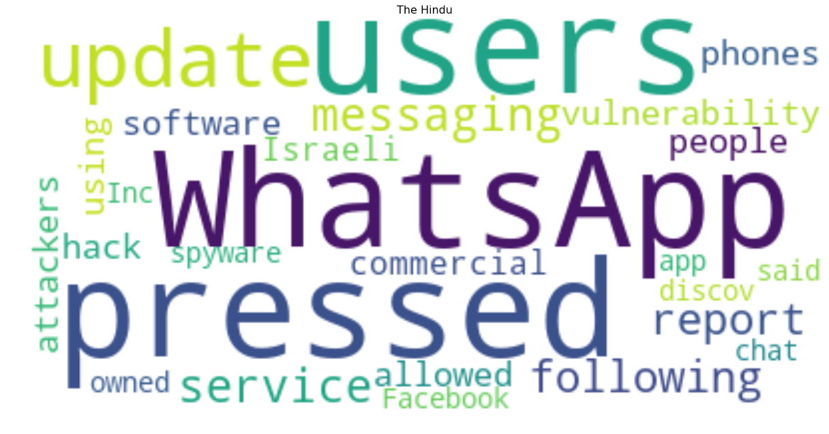
WhatsApp Spyware Attack In Times Of India and The Hindu
By: Bhagya Sree Chanda| Advisor: Dr. Nathan Eloe
Email: S534662@nwmissouri.edu
Question
Results
Conclusion
How different are two newspapers discussing a specific news, Which Newspaper is best to read?
The main objective of this project is analyze how both Newspapers(Times Of India and The Hindu) reacted to major incident on WhatsApp. Also to analyze the content of these two Newspapers addressing the matter.
Results 1: Results 2:
Results 3: Times of India The Hindu
From both the graphs we can clearly state that "Times of India" is a Newspaper with a more negative compound than The Hindu newspaper.
The Hindu seems to have more aggressive language in the most common words (targeted, hack, attackers), while the Times of India is written more diplomatically
The Hindu has used 202 different words where as Times of India has used 171 different words only.
The Hindu has more lexical diversity than TOI. Hence, reading The Hindu can help people in learning more new different words.
Times of India Common Words | The Hindu Common Words
WhatsApp | Intelligence
Vulnerability | Operating
Spyware | Targeted
Globally | Vulnerability
Operating | Software
Compromise | Allowed
Developed | Attackers
Industry | Information
Hallmarks | Investigation
Materials/Methods
Sentiment Analysis was performed on the content published on the online Newspapers.
Sentiment analysis was done and compared between both newspapers.
“9 Most frequently used words” other than conjunctions, articles from the newspapers was printed in a table
The content published by both newspapers, those words are taken and then word cloud was generated.
API’s Used: BeautifulSoup, requests, numpy, matplotlib, collections, wordcloud , PIL, random, nltk
Further Information
https://github.com/44520-s19/wm-final-project-bhagyasree2895

